Slide 1
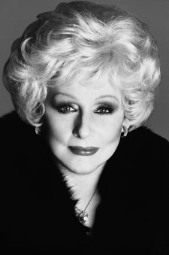

Slide 2
Mary Kay Career Path
Consultant
Avenues of Income
Product Sales and reorders
Rewards
Mary Kay Pin
Applause Magazine
Eligible to attend Seminar and Career Conference
Eligible to qualify for quarterly Star Consultant recognition and prizes

Slide 3
Senior Consultant
Avenues of Income
Product Sales and reorders
Team-building commissions
Compensation
4% personal team commission
Rewards
1 Active Personal Team Member: Eligible to wear Senior Beauty Consultant pin enhancer
2 Active Personal Team Members: Eligible to order red jacket
Eligible to qualify for quarterly Star Consultant recognition and prizes Requirements*
1 to 2 active personal team members
You must be active.

Slide 4
Star Team Builder
Avenues of Income
Product sales and reorders
Team-building commissions
Team-building bonus
Compensation
4% personal team commission
Team-building bonus
Rewards
Eligible to wear Star Team Builder pin enhancer
Eligible to wear red jacket
Receive $50 rebate on the purchase of the official red jacket available only from Mary Kay Inc.
Eligible to qualify for quarterly Star Consultant recognition and prizes
Requirements
3 to 4 active personal team members
You must be active.

Slide 5
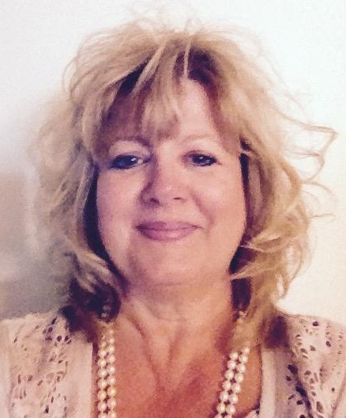
NEW Star Team Builder
Kelly Lawrence
of the Wallace Unit

Slide 6
Team Leader
Avenues of Income
Product sales and reorders
Team-building commissions
Team-building bonus
Compensation
9% or 13% personal team commission
Team-building bonus
Rewards
Eligible to wear Team Leader pin enhancer
Eligible to go on-target for Grand Achiever status (Grand Achiever Career Car or Cash Compensation option)
Eligible to qualify for quarterly Star Consultant recognition and prizes
Requirements
5 to 7 active personal team members
You must be active.

Slide 7
Future Independent Sales Director
Avenues of Income
Product sales and reorders
Team-building commissions
Team-building bonus
Compensation
9% or 13% personal team commission
Team-building bonus
Rewards
Eligible to wear Future Ind. Sales Director pin enhancer
Eligible to wear Future Ind. Sales Director scarf
Eligible to submit Sales DIQ commitment form
Must have 10 or more active personal team members; refer to section, “Prior to entering the Sales Director-in-Qualification Program” under Independent Sales Director-in-Qualification for details.
Eligible to go on-target for Grand Achiever status (Grand Achiever Career Car or Cash Compensation option)
Eligible to qualify for quarterly Star Consultant recognition and prizes
Requirements
8 or more active personal team members
You must be active.

Slide 8
Independent Sales Director in Qualification
Avenues of Income
Product sales and reorders
Team-building commissions
Team-building bonus
Compensation
4%, 9%, or 13% personal team commission
Team-building bonus
Requirements
For DIQ qualifications, see your Director

Slide 9
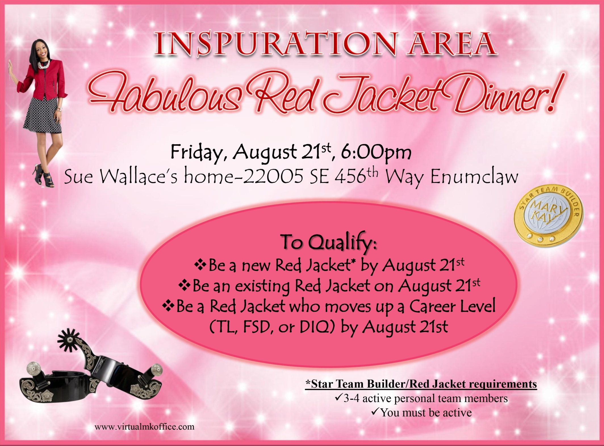

Slide 10
Inspuration Area DIQ’s
Kari Hartley, Huston Unit
Laura Johnson, Holloway Unit
Morgan Torres, Fish Unit

Slide 11
Independent Sales Director
Avenues of Income
Product sales and reorders
Team-building commissions
Leadership
Compensation
4%, 9%, or 13% personal team commission
Class of 2016

Slide 12
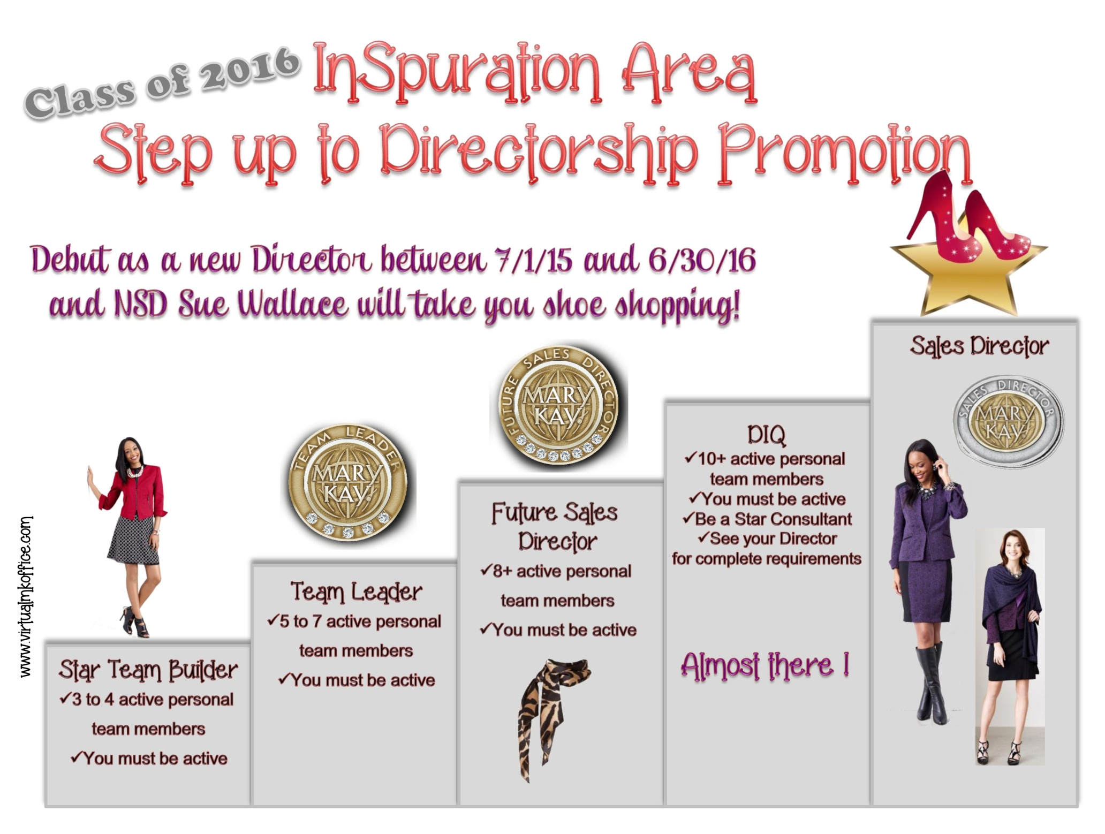

Slide 14
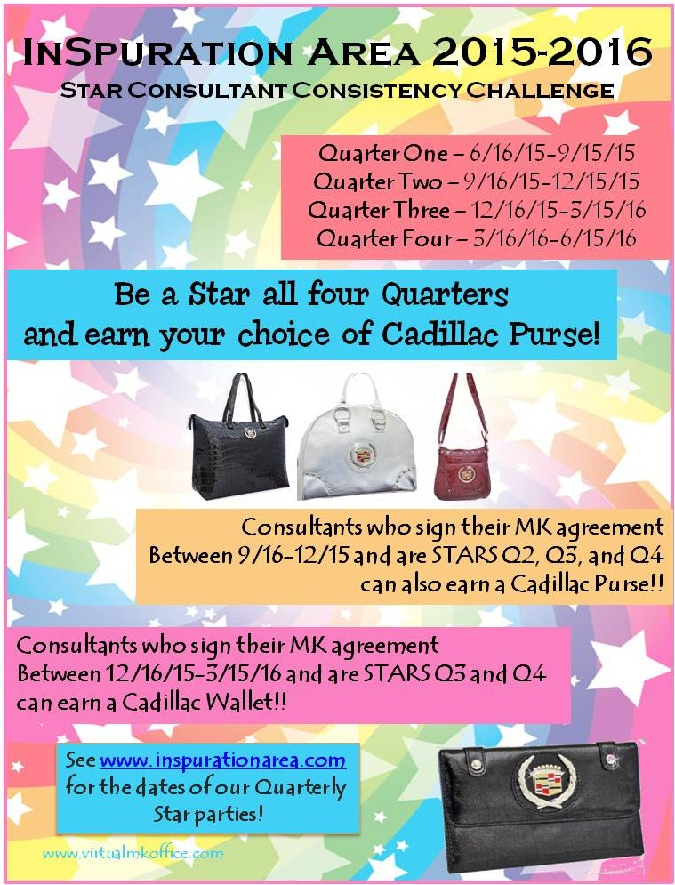

Slide 15
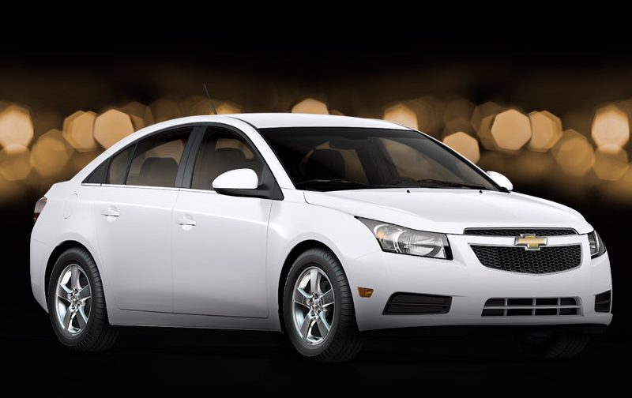
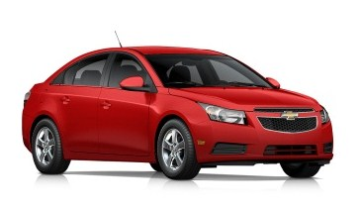
Mary Kay Career Cars
Grand Achiever earns the Chevy Cruze
Choose White or Red!

Slide 16
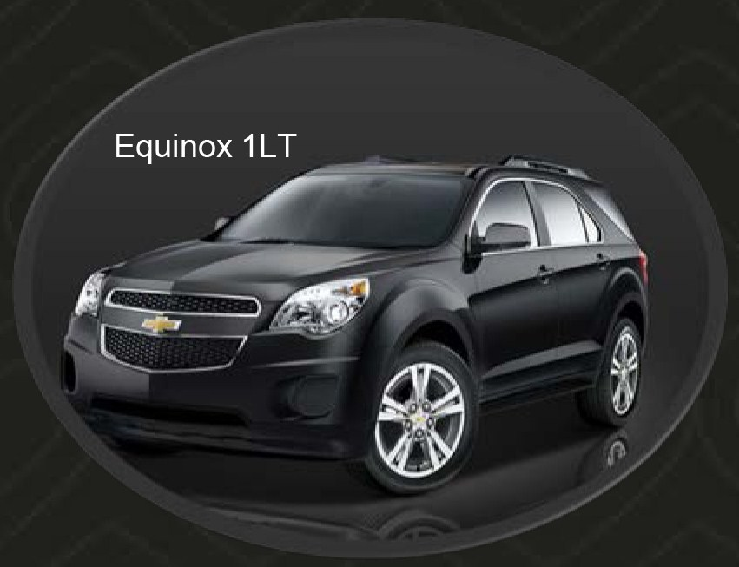
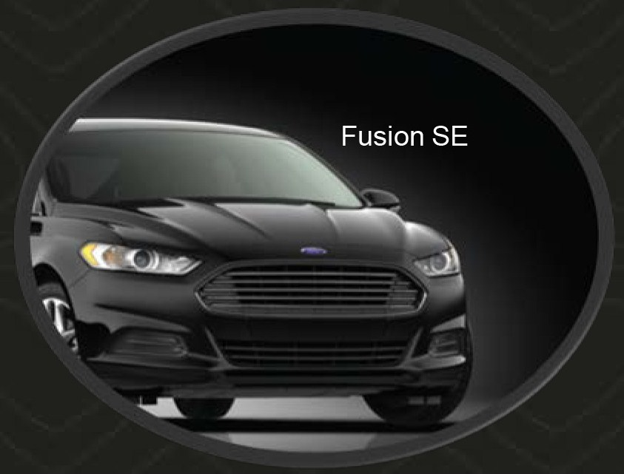
Mary Kay Career Cars
Premier Club NEW Ford Fusion
or Chevy Equinox

Slide 17
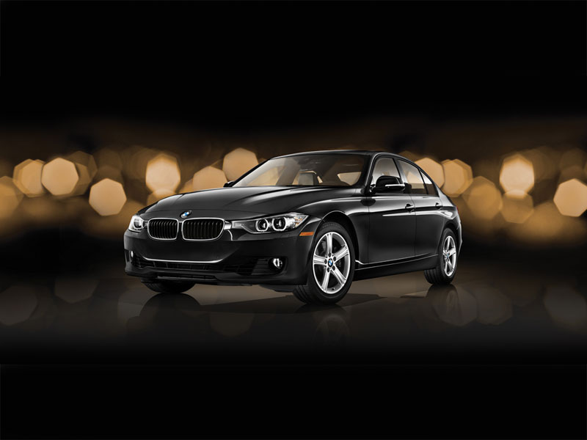
Mary Kay Career Cars
Premier Plus-BMW 320i
Extended through Dec 2015!

Slide 18
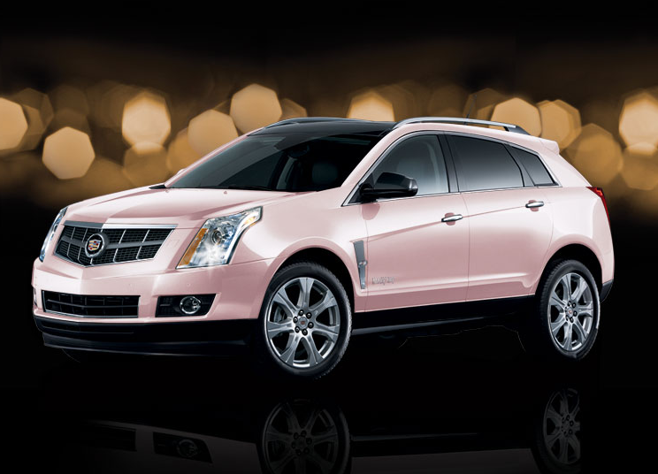
Mary Kay Career Cars
Cadillac SRX

Slide 19
Don't miss the Weekly Conference Call
Tuesday nights at 7:00pm PST
The dial in number is 712/432-0927, access 206693#.

Slide 20
Upcoming Guest Events
8/8 – Muffins and Makeovers, Dream Center, 10am
8/8 – Olympia Brunch, Indian Summer CC, 9:45am
8/9 – Career Coffee, Lisa Semon’s 2:30pm
8/10 – Career Coffee, Virginia Doll’s, 5:30pm
For complete information, see your Unit's website under upcoming events.

Slide 21
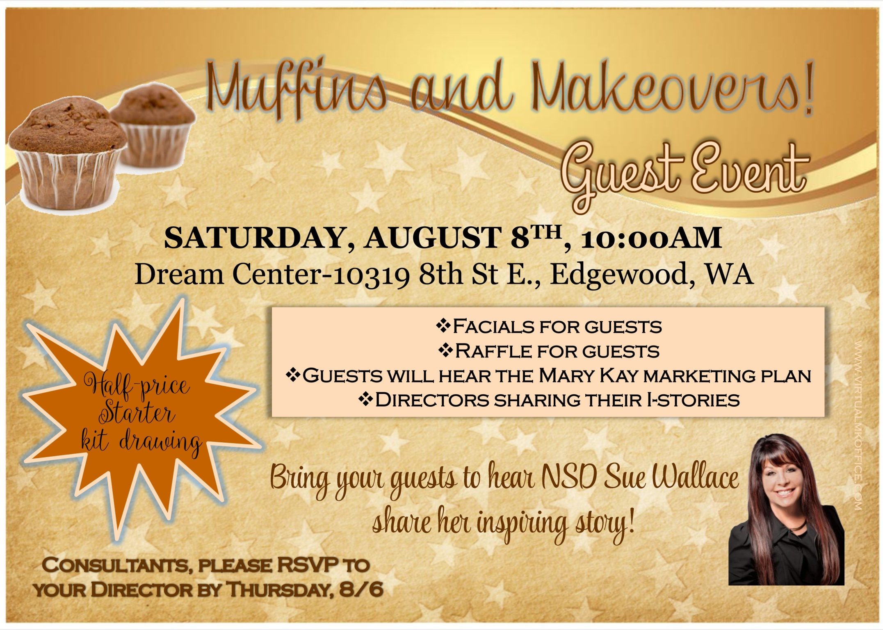

Slide 22
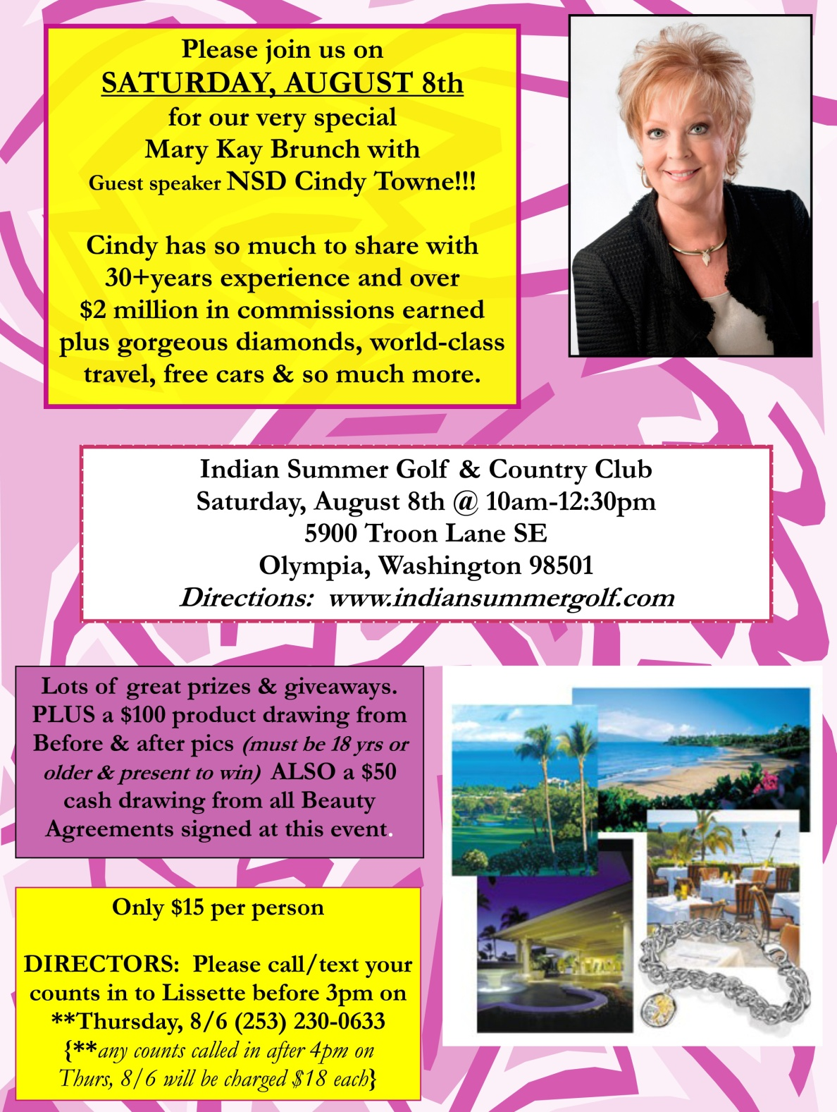

Slide 23
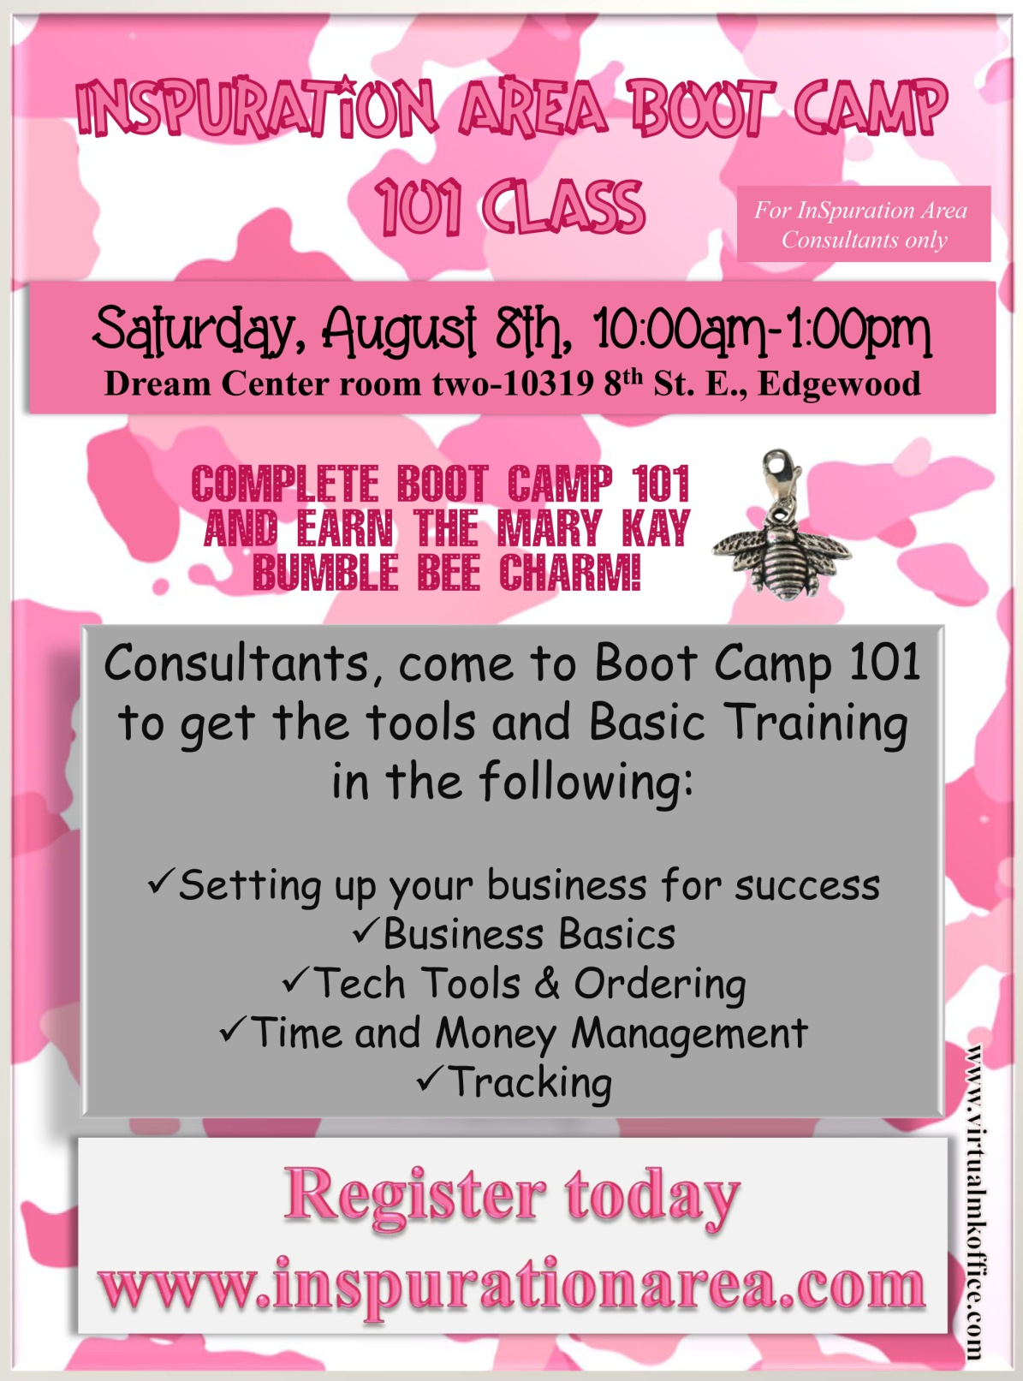
Register for Boot Camp 101
at www.inspurationarea.com

Slide 25
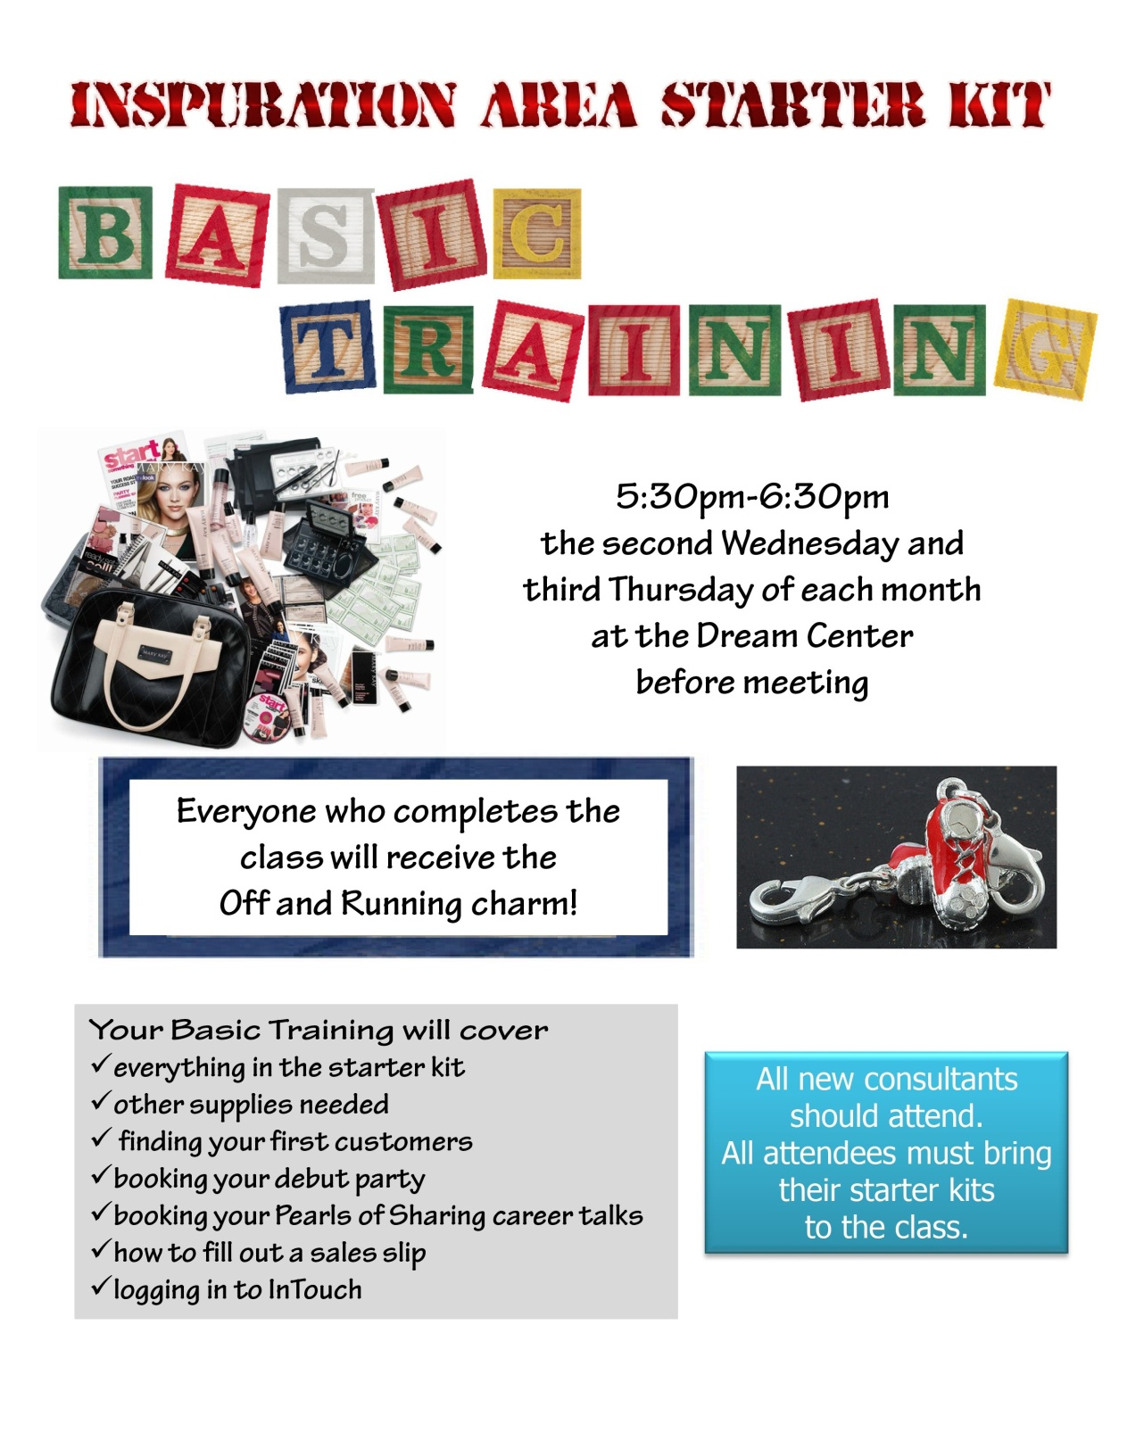

Slide 26
Words of Wisdom from Mary Kay Ash
In order to attract and retain good people, a business must treat people right. Without people skills, no organization - and for that matter, no manager - can make it in today's highly competitive business environment.

Slide 27
On Silver Wings
I have a premonition that soars on Silver Wings
It is a dream of your accomplishments
of many wondrous things.
I do not know beneath which sky or
where you'll challenge fate
I only know it will be high
I only know it will be GREAT!
Anonymous

Slide 28
Tributes to our Founder
Laura Bush, First Lady (2000 – 2008)
"Mary Kay is someone I have always admired.
I believe that America's greatness is due in large part to courageous people like Mary Kay who have never been afraid to stand up for what is right."

Slide 29
Tributes to our Founder
Doretha Dingler, Mary Kay Independent Elite Executive National Sales Director Emeritus
"Mary Kay asked that we take our families along on this journey. She knew that if we mold ourselves into positive, inspiring role models for our families, they would have a head start on living their own journey successfully. "She has empowered women and enabled them to build a better life for themselves and their families. Mary Kay will go down in history as one of the greatest female humanitarians and visionaries of our time."

